Slide 1
About the Company
Founded in 2008, Advance Solutions Corp. is a ServiceNow Partner providing outstanding ServiceNow development, implementation, and deployment of services to enterprise customers worldwide.
This is a US based company with their offices expanding in USA, Singapore, Vancouver.
Their goal is to make cloud-based service management quick and easy for their customers, ultimately improving company productivity, organization, and culture.

Slide 2
Summer Internship Project
Arun Bagga
B.Tech (ECE)
16106013

Slide 3
About ServiceNow
ServiceNow is an American cloud computing company with its headquarters in Santa Clara, California.
It was founded in 2004 by Fred Luddy. ServiceNow is listed on the New York Stock Exchange.
It has many top IT Service Companies around the world as its partners such as HCL, TCS, Wipro. Advance Solutions Corp. is also one of them.
Here the projects are gathered by a marketing team in US and are forwarded to teams of technical consultants across the world who develop the required application’s front end and back end functionalities.
Using ServiceNow for application development has proved to be a lot more efficient and professional than working from the scratch because of the in-built functionalities (called “Out Of The Box features”).
Moreover the platform has a well-defined documentation and an active Community to assist the developers who get stuck.

Slide 4
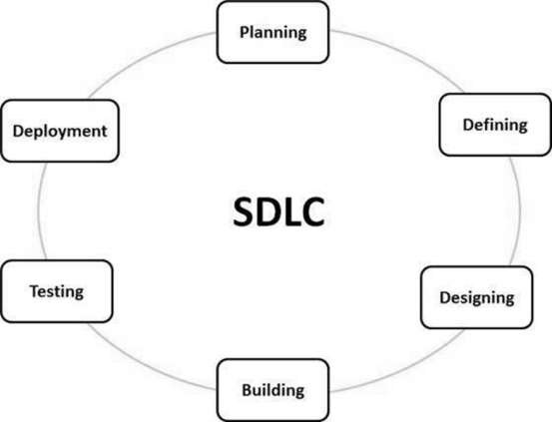
SDLC (Software Development Life Cycle)
SDLC is a process followed for a software project, within a software organization. It consists of a detailed plan describing how to develop, maintain, replace and alter or enhance specific software. The life cycle defines a methodology for improving the quality of software and the overall development process.

Slide 5

Project Title Restaurant Management System

Slide 6
Project Goals
To create such a restaurant system which will save time of both customers and restaurant management team.
To work as a consumer app which allows your customers to view the restaurant menu, add feedback and read stories or review of other customers.
To manage employees, maintain the entire kitchen and be a bookkeeper.
With this system when customers can order food, order’s copy will go to kitchen and manager or cash counter immediately.
With this system one can store entire restaurant menu, in a synchronized manner where every item is in particular category and these categories are updated and deleted by the manager or any technical consultant.

Slide 7
User login Options.
Table Number: Customers will get their ordering device on the table. Their instance will be logged in with the ID of the table they are sitting on.
Chef: Each group head of chef will have their device so that hey can check what orders to be cooked.
Manager: Manager’s device will keep track of all the activities and generate bill after order is completed.

Slide 8
Features Included
Menu, Price of items, Food Selection and order option: All these are stored in as ’Menu Items’>’Categories’>’Catalog Items’.
Order flow to kitchen and cash counter: This operates with the help of the workflows.
Bill Receiving System: Manager gets a task to generate the bill and get it collected from the customer.

Slide 9
Working of the Project

Slide 10
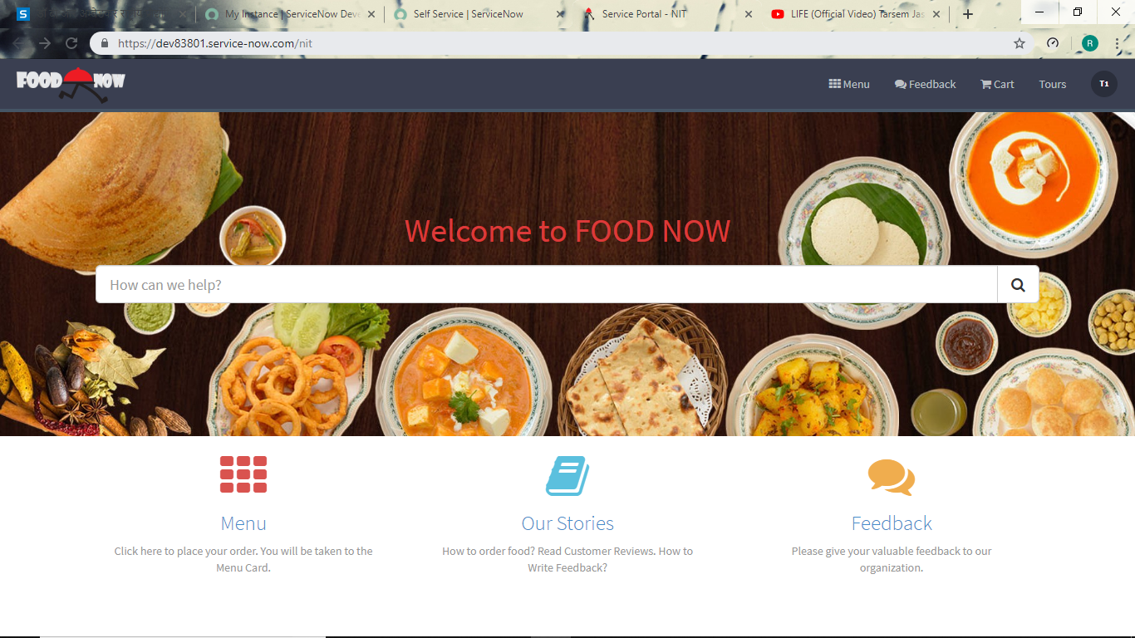
The customer will get the following screen on their device. This is the logged in portal for type Table user. Currently Table1 is logged in as in the top right corner of the page. Here, we have the following widgets:
Search bar can be used to creating incidents (like when some dish gets spilled on the table or some false order received etc.), ordering food directly without going through complete menu or read some knowledge article.
This takes us to a few knowledge articles. There are knowledge articles about how to order the food, how to leave feedback and some reviews about the restaurant by previous customers.
This icon leads the customer to the feedback form. Users can add their valuable feedbacks here.
This menu icon takes the user to the restaurant menu. This menu will be discussed in the later part.

Slide 11
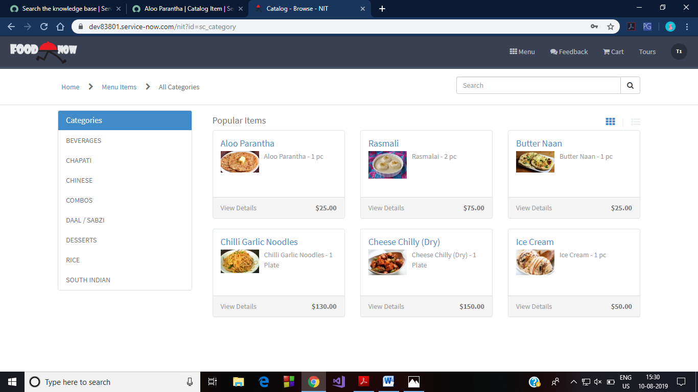
On this screen, the user will select the Menu icon. This will lead to the following webpage that shows some most popular food items and the food categories. In this page, on the left side are the food item categories. Popular items include the catalog items that have been ordered the most by the customers.

Slide 12
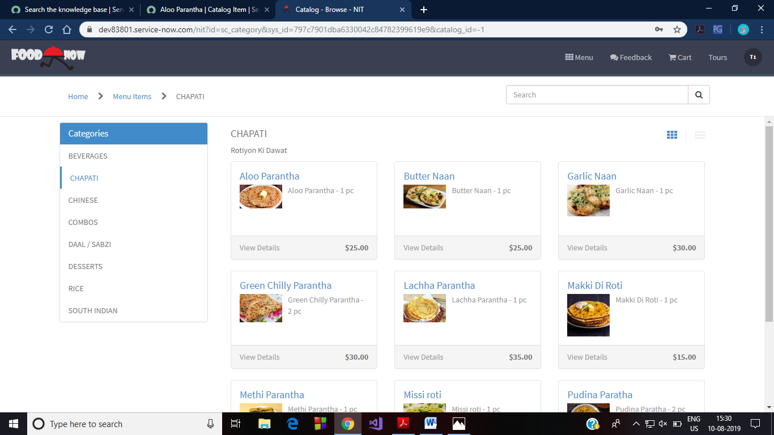
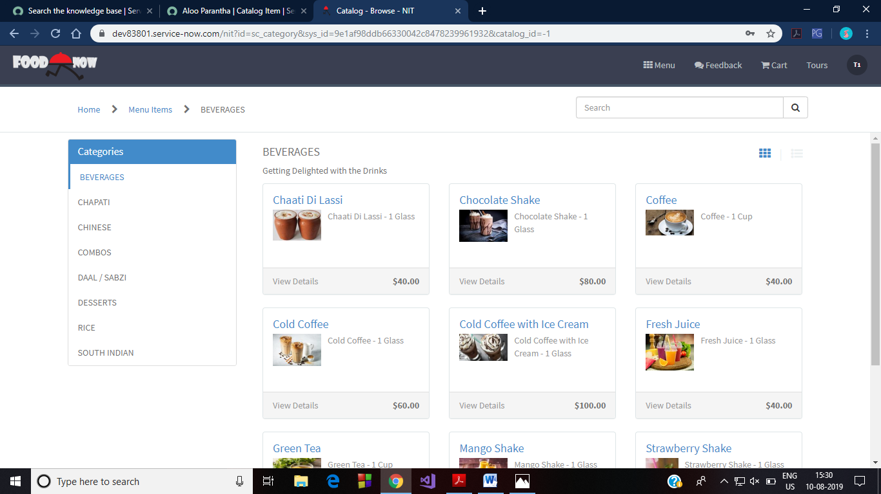
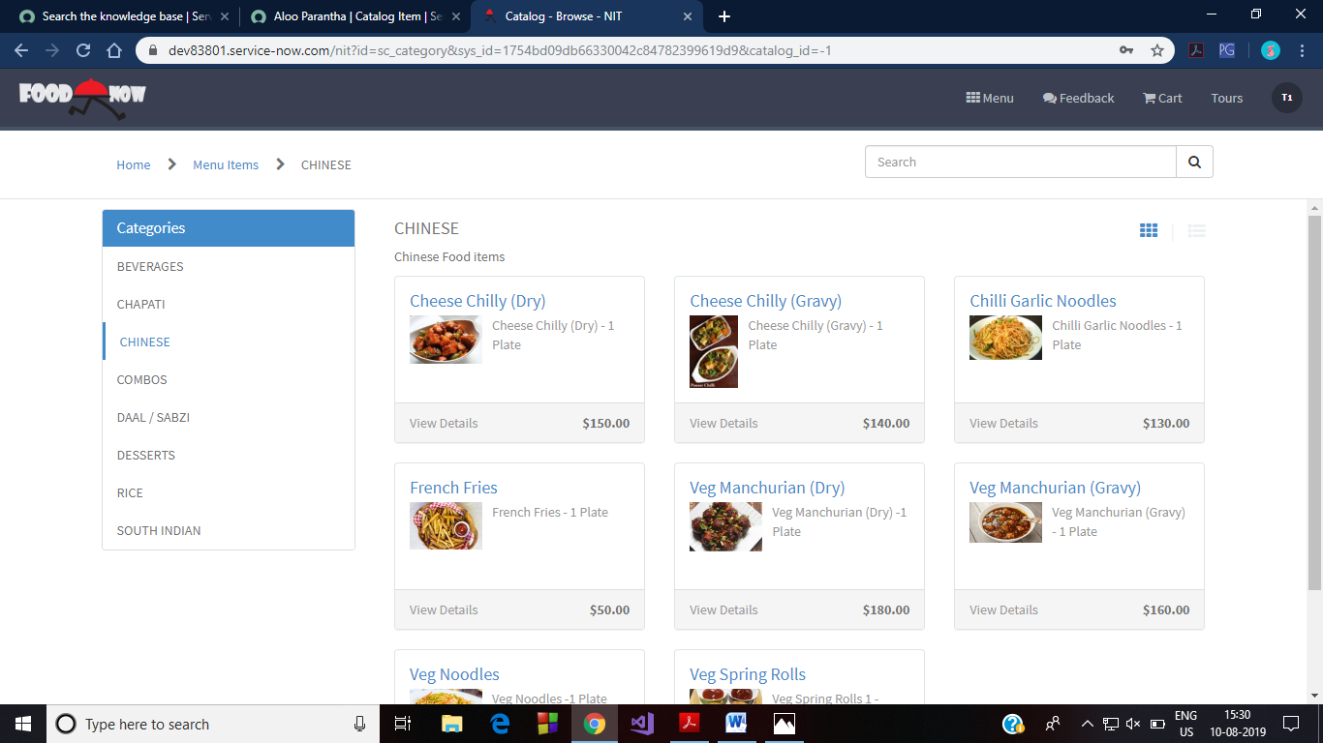
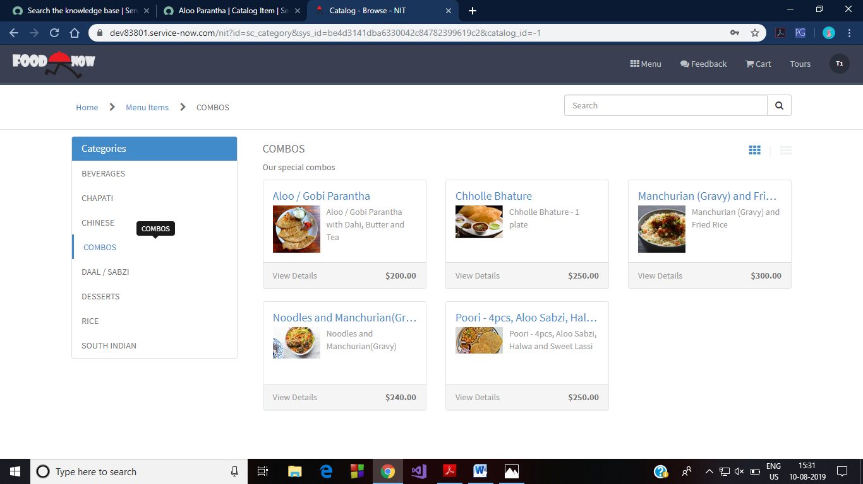
. Clicking on the category will show the catalog items related to that category. Following are the screenshots of these categories:

Slide 13
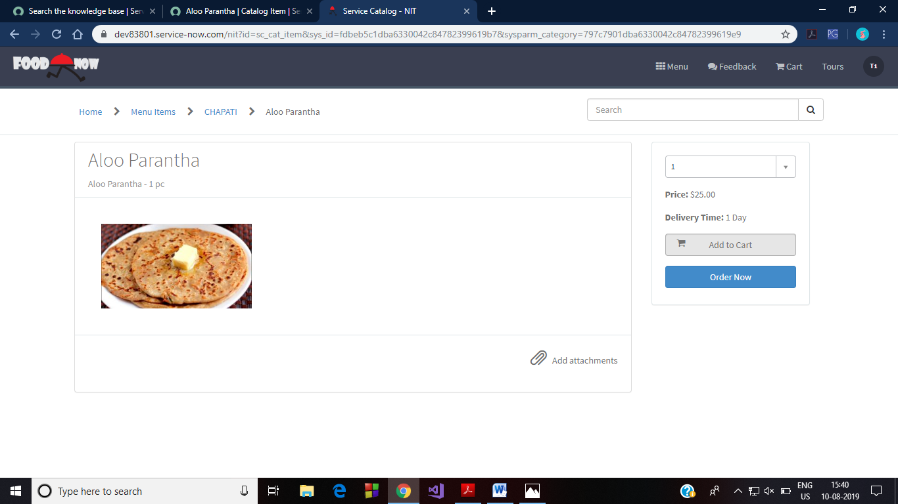
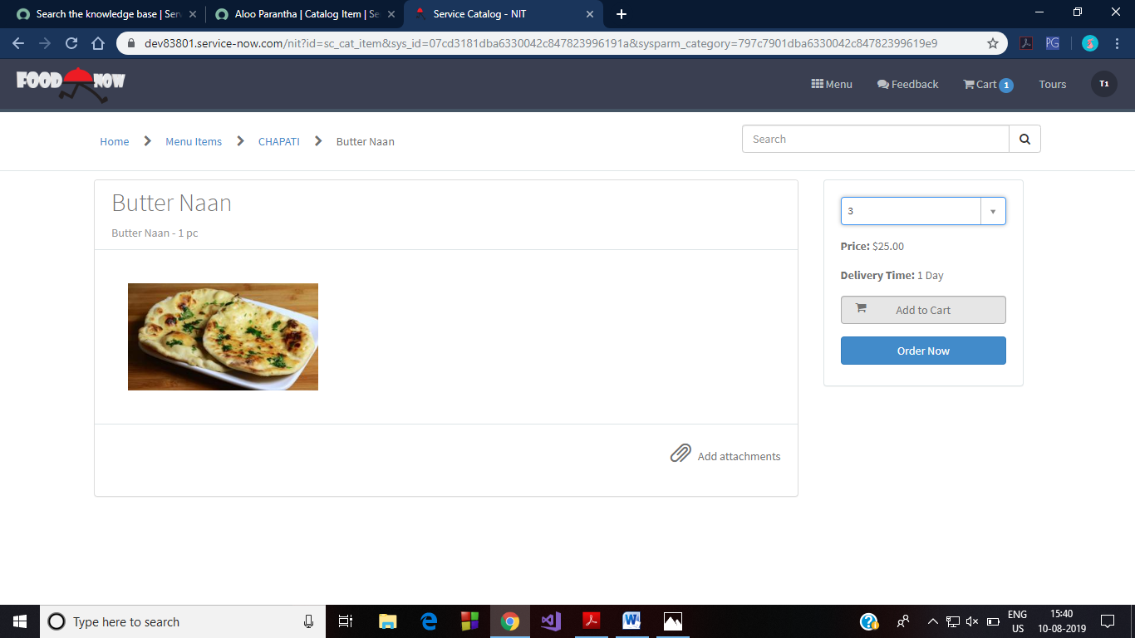
Let’s consider that we have ordered 1 Aloo Parantha and 3 Butter Naan. For this, we select ‘Chapati’>’Aloo Parantha’ and ‘Chapati’>’Butter Naan’. This is shown below:

Slide 14
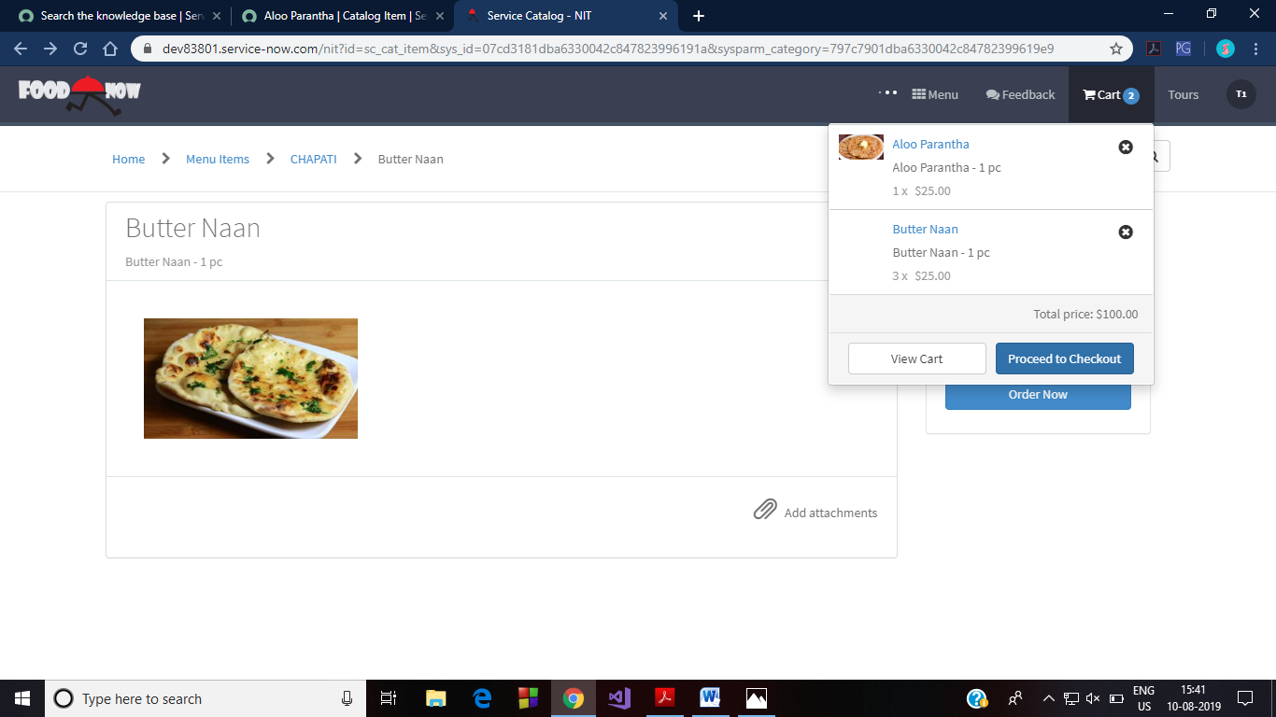
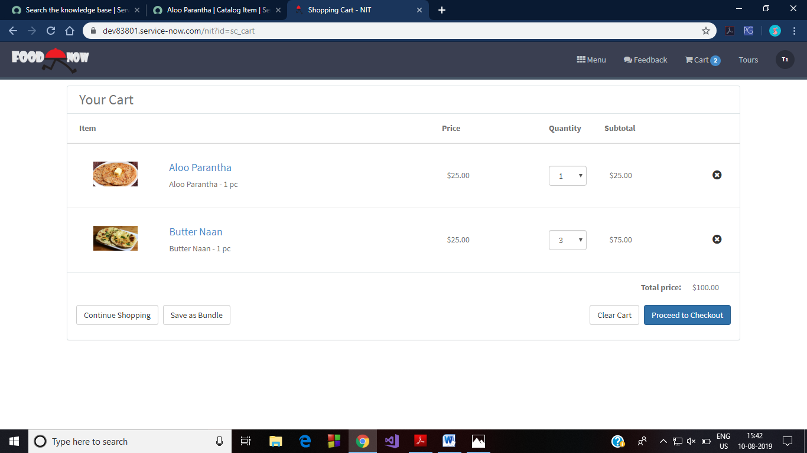
Further, the order is placed by clicking on Cart menu. There we can view our orders. Click on Proceed to Checkout.

Slide 15
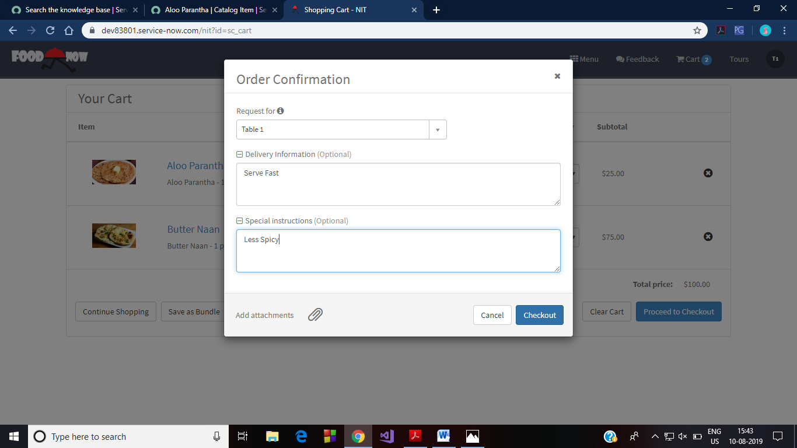
This generates a popup that asks you to add further specifications. Clicking on ‘Proceed’ finally places the order.
The order has now been placed. This creates the task for the corresponding chef. Now the order has gone to the chef as per the category of the item ordered. After the chef logs in, in the Orders menu in the header bar, there will be an entry corresponding to each item of the order. The chef can start preparing the order seeing the quantity and the item name.

Slide 16
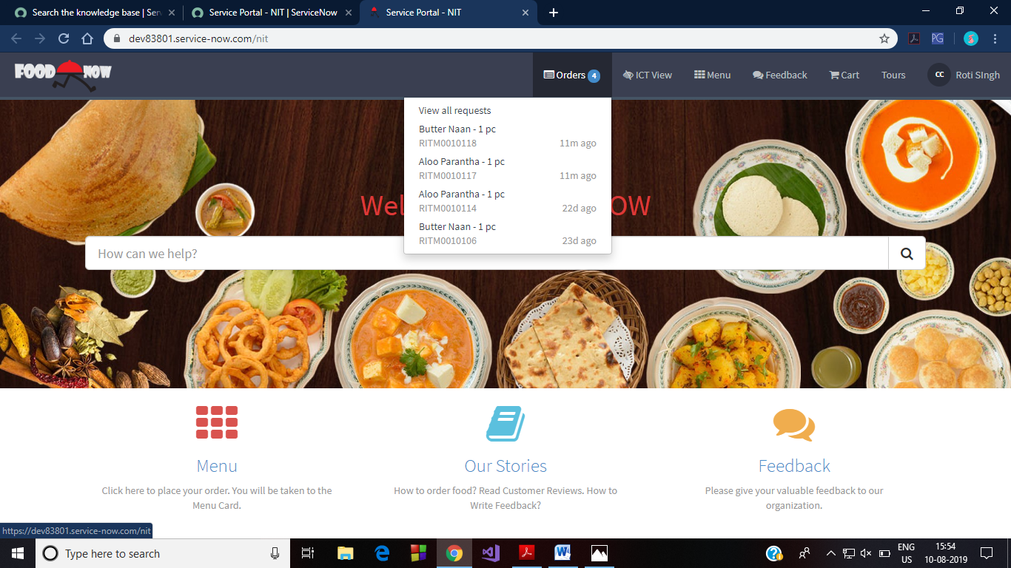
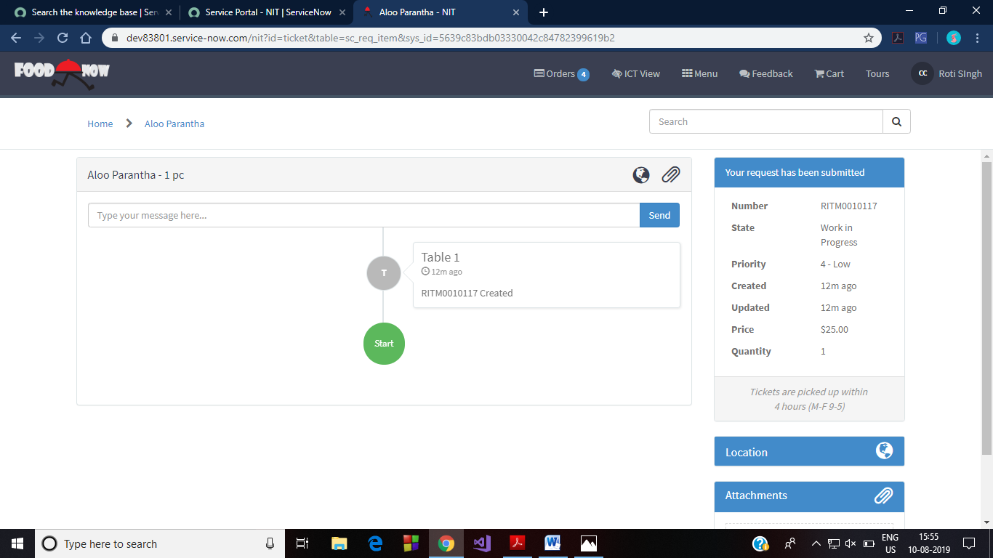
The chef login screen and the order menu in the header bar are shown in the figure. Quantity can be seen by clicking on the request.

Slide 17
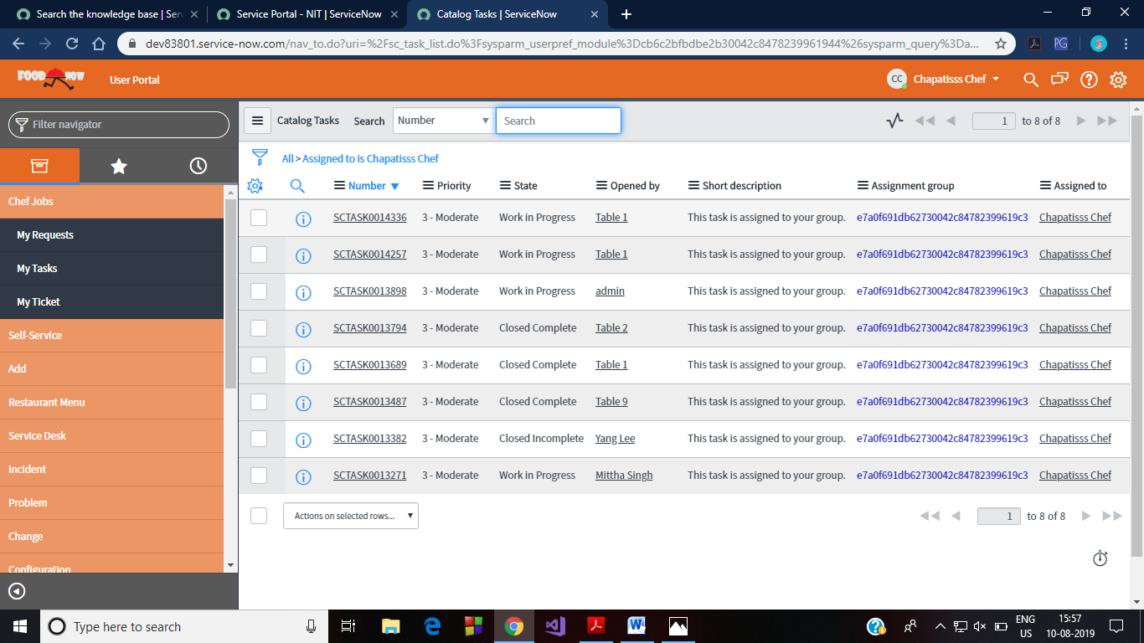
After preparing the order, the chef has to open ICT view in the header menu. Then select My Tasks from navigator menu.

Slide 18
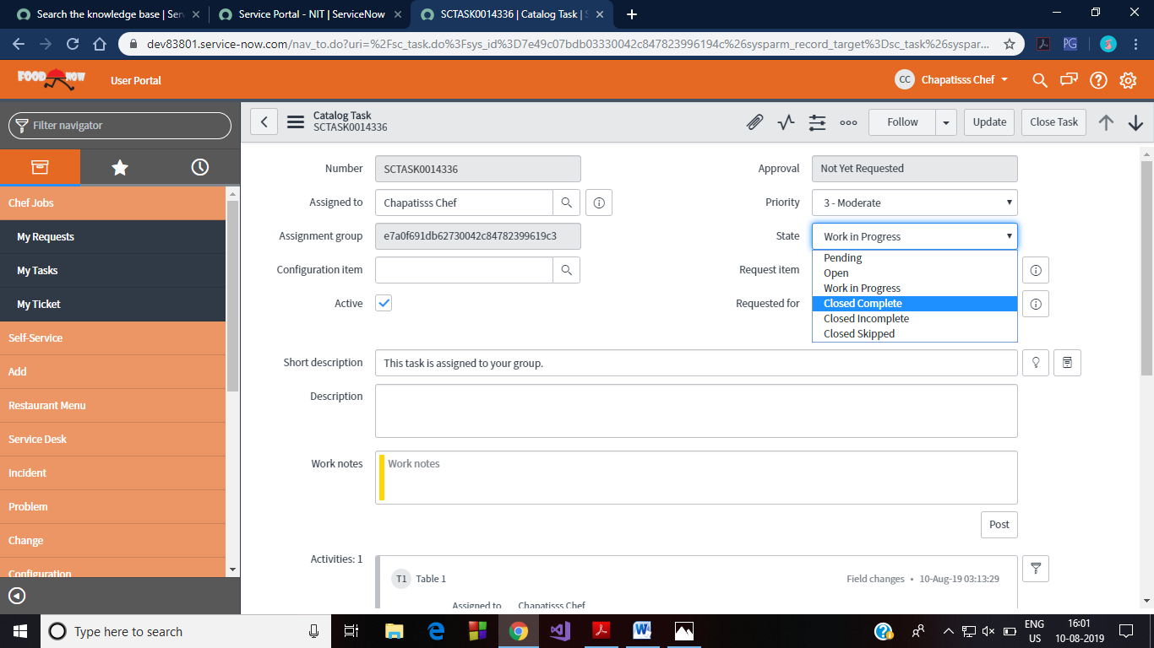
Here the chef has to select the item prepared and then change its state to close complete or directly close task. The manager gets a task to generate for that table.

Slide 19
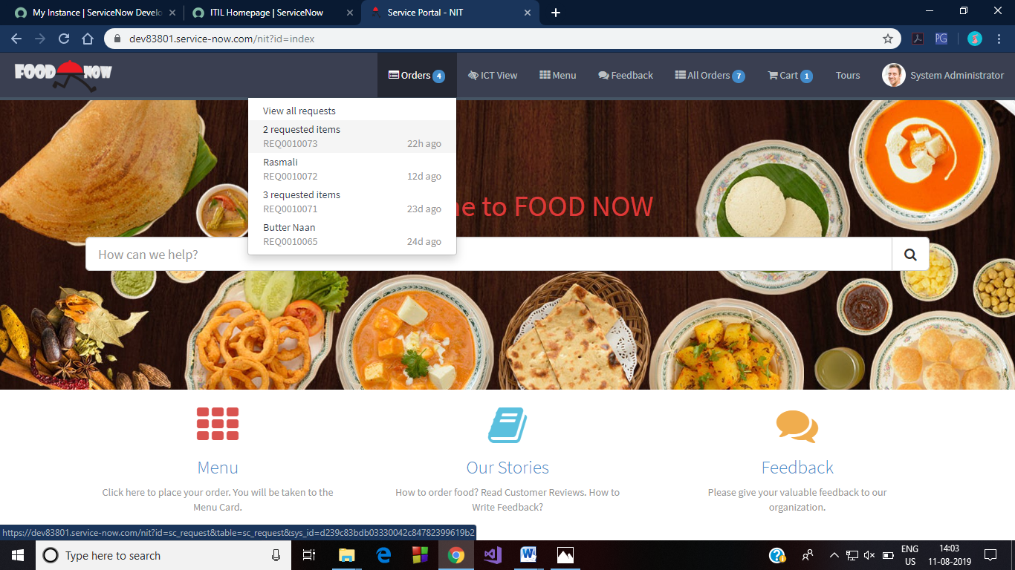
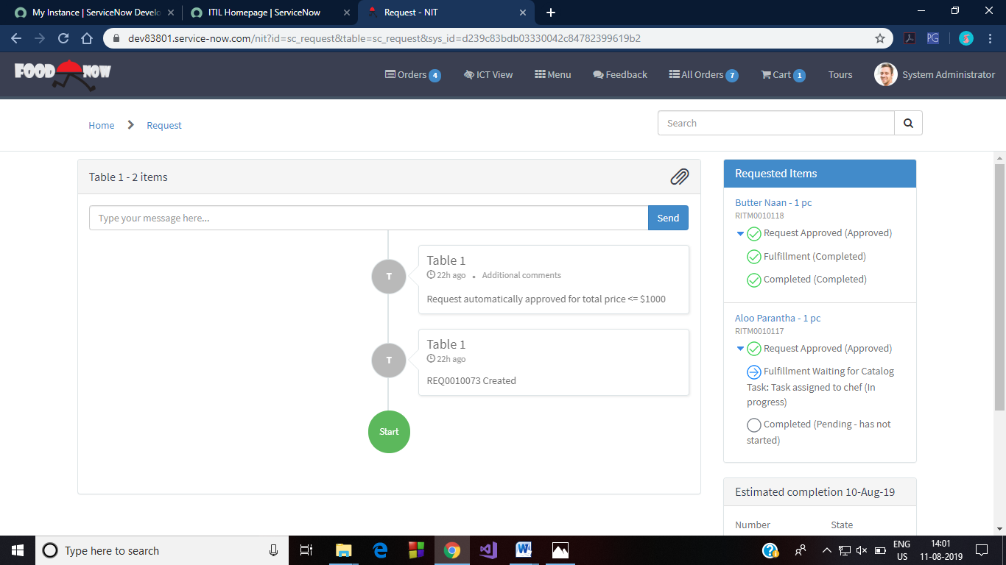
In manager’s logged in header menu, each of the order gets displayed. Based on this information, the manager will get create the bill and send it to the corresponding table. This process is as explained in the following figure.

Slide 20
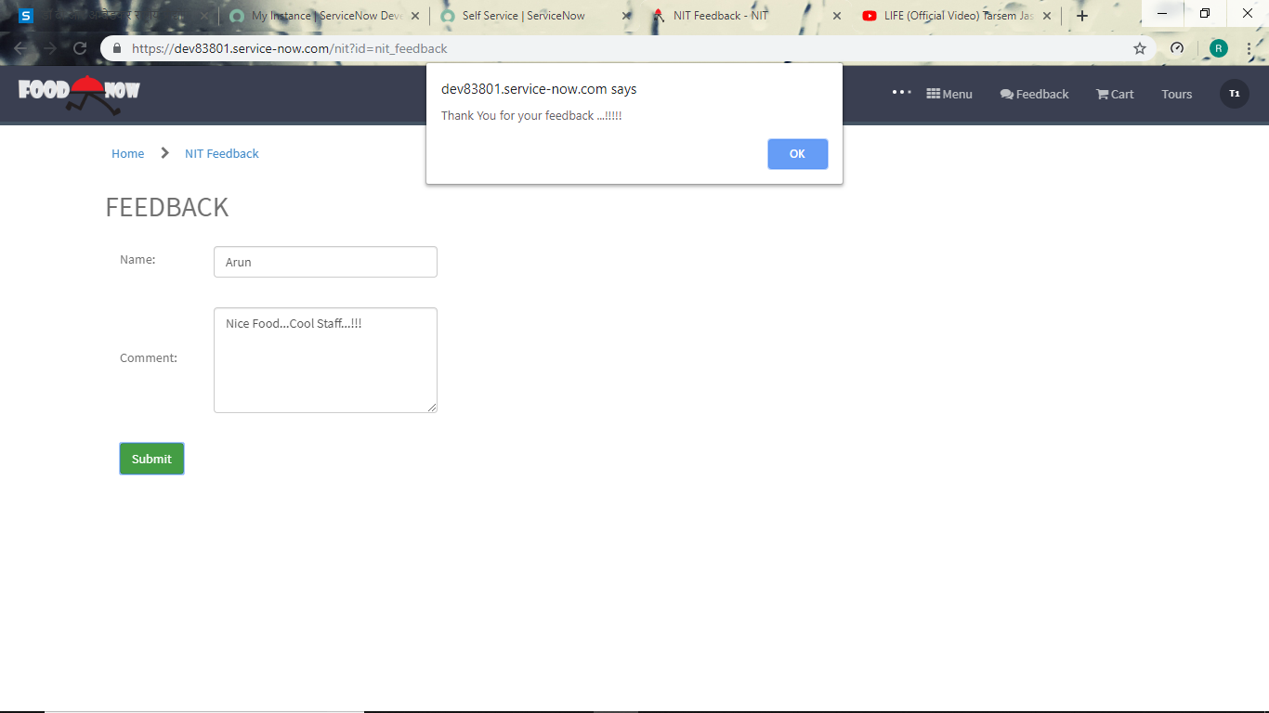
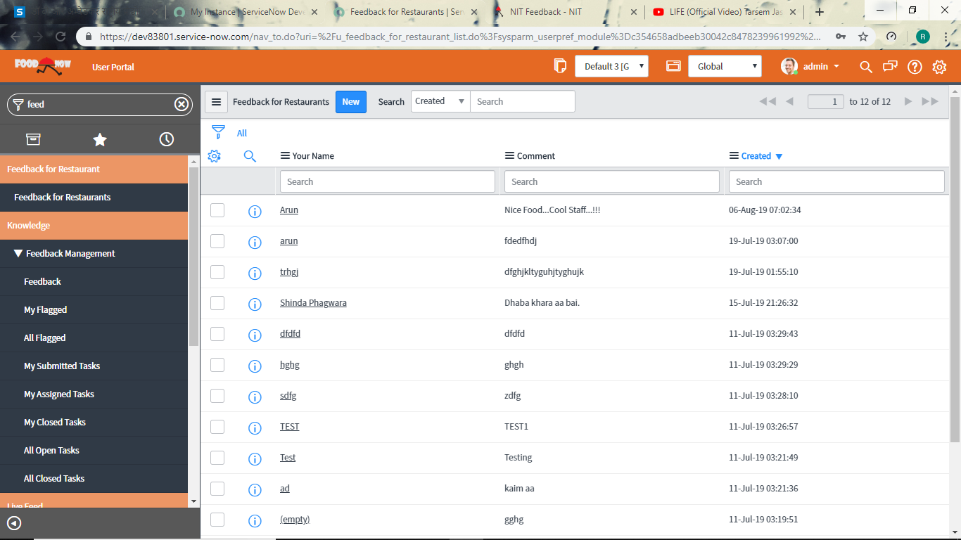
Inner Implementations
Workflows
Chef Assignment Workflow
Bill Generator Workflow
Restaurant SLA 2
Catalog Item SLA
Feedback

Slide 21
Thank You

